Slide 1
PROJECT TITLE Internship Project On Feature Extraction and Prediction for mobile phones (Project -04)
PRESENTED BY
MANISH KAUSHIK
INTERNSHIP ORGANISATION
Next Hikes IT Solution

Slide 2
What is Feature Extraction ?
Feature extraction is a part of the dimensionality reduction process, in which, an initial set of the raw data is divided and reduced to more manageable groups. So when you want to process it will be easier. The most important characteristic of these large data sets is that they have a large number of variables. These variables require a lot of computing resources to process. So Feature extraction helps to get the best feature from those big data sets by selecting and combining variables into features, thus, effectively reducing the amount of data. These features are easy to process, but still able to describe the actual data set with accuracy and originality.

Slide 3
Why Feature Extraction is Useful?
The technique of extracting the features is useful when you have a large data set and need to reduce the number of resources without losing any important or relevant information. Feature extraction helps to reduce the amount of redundant data from the data set.
In the end, the reduction of the data helps to build the model with less machine effort and also increases the speed of learning and generalization steps in the machine learning process.

Slide 4
Applications of Feature Extraction
Bag of Words- Bag-of-Words is the most used technique for natural language processing. In this process they extract the words or the features from a sentence, document, website, etc. and then they classify them into the frequency of use. So in this whole process feature extraction is one of the most important parts.
Image Processing –Image processing is one of the best and most interesting domain. In this domain basically you will start playing with your images in order to understand them. So here we use many many techniques which includes feature extraction as well and algorithms to detect features such as shaped, edges, or motion in a digital image or video to process them.
Auto-encoders: The main purpose of the auto-encoders is efficient data coding which is unsupervised in nature. this process comes under unsupervised learning . So Feature extraction procedure is applicable here to identify the key features from the data to code by learning from the coding of the original data set to derive new ones.

Slide 5
Difference Feature Selection and Feature Extraction Methods
Feature selection and feature extraction methods have their advantages and disadvantages, depending on the nature of the data and the task at hand.
 | Feature Selection | Feature Extraction
1. | Selects a subset of relevant features from the original set of features. | Extracts a new set of features that are more informative and compact.
2. | Reduces the dimensionality of the feature space and simplifies the model. | Captures the essential information from the original features and represents it in a lower-dimensional feature space.
3. | Can be categorized into filter, wrapper, and embedded methods. | Can be categorized into linear and nonlinear methods.
4. | Requires domain knowledge and feature engineering. | Can be applied to raw data without feature engineering.
5. | Can improve the model’s interpretability and reduce overfitting. | Can improve the model performance and handle nonlinear relationships.
6. | May lose some information and introduce bias if the wrong features are selected. | May introduce some noise and redundancy if the extracted features are not informative.

Slide 6
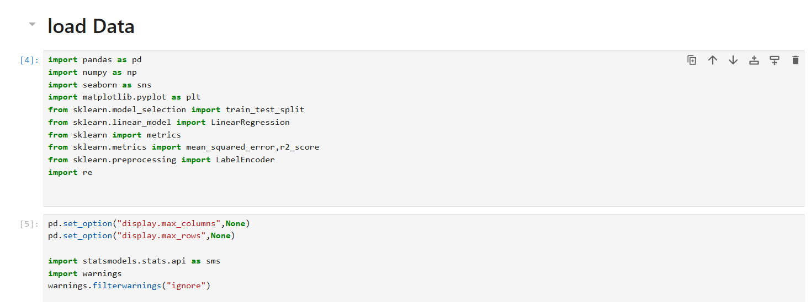

Slide 7
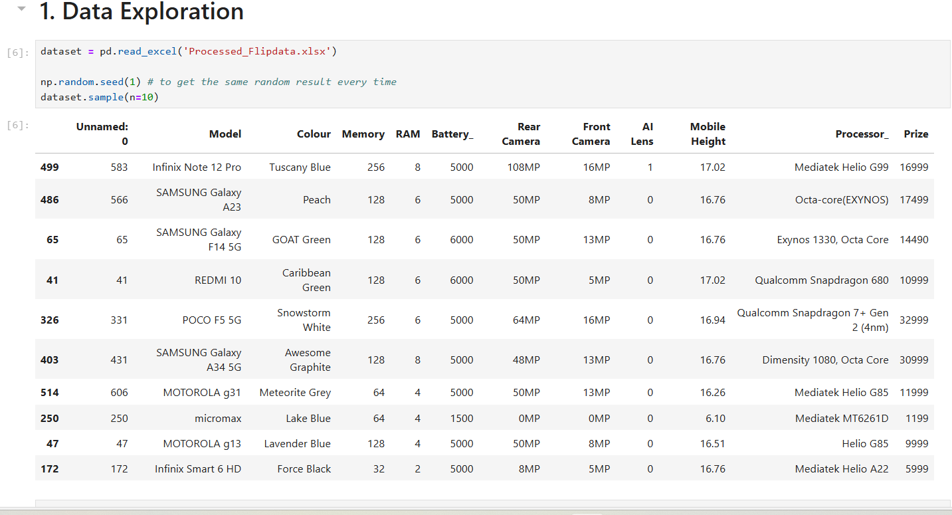

Slide 8
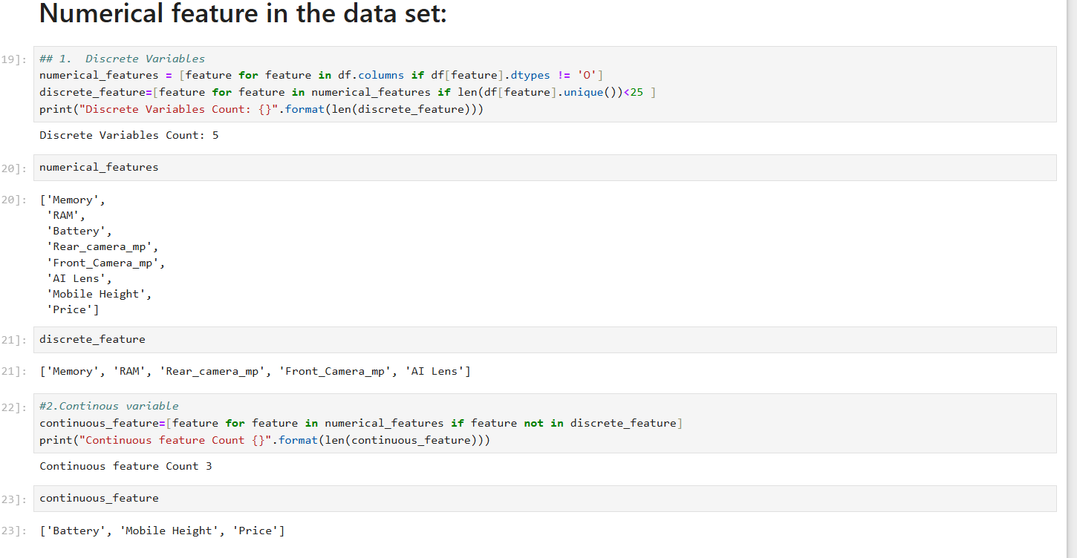

Slide 9
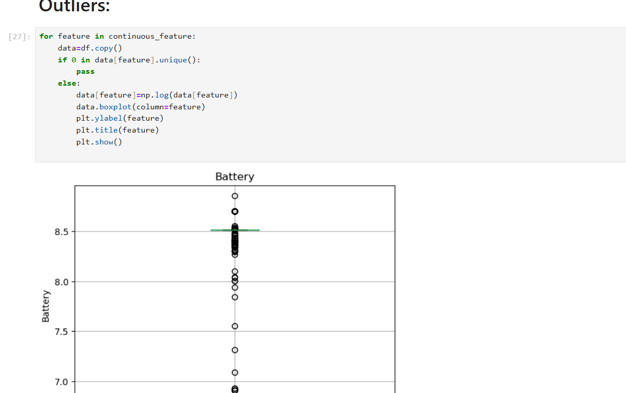

Slide 10
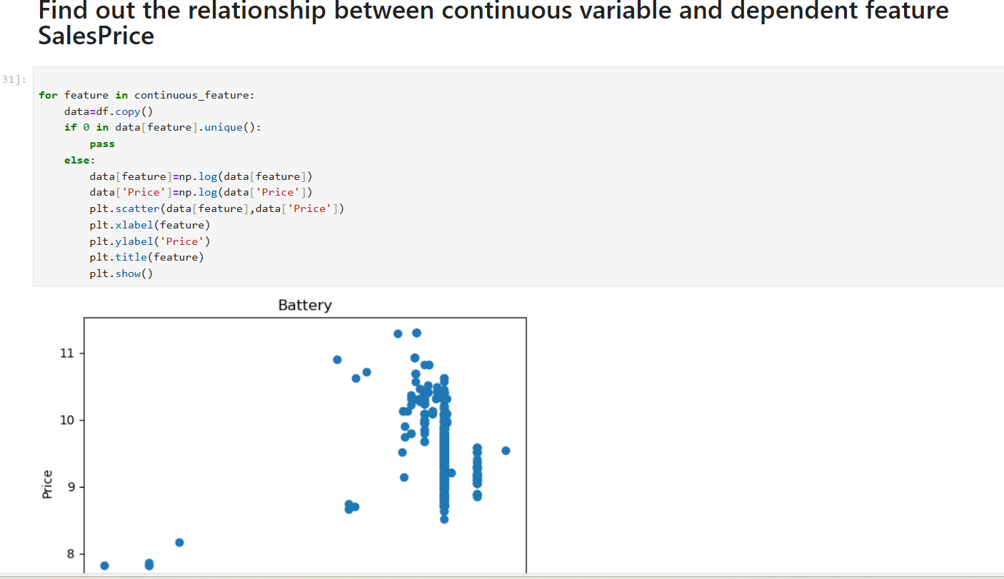

Slide 11
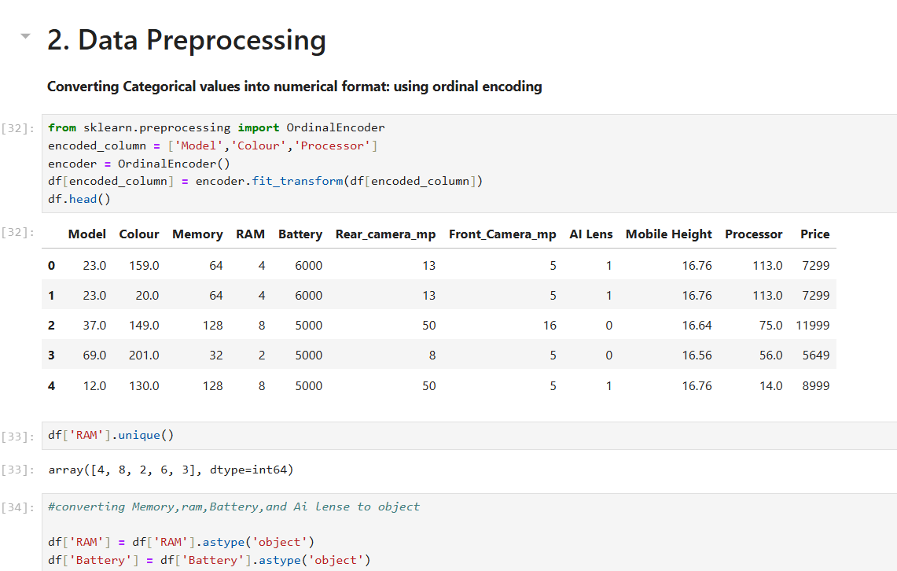

Slide 12
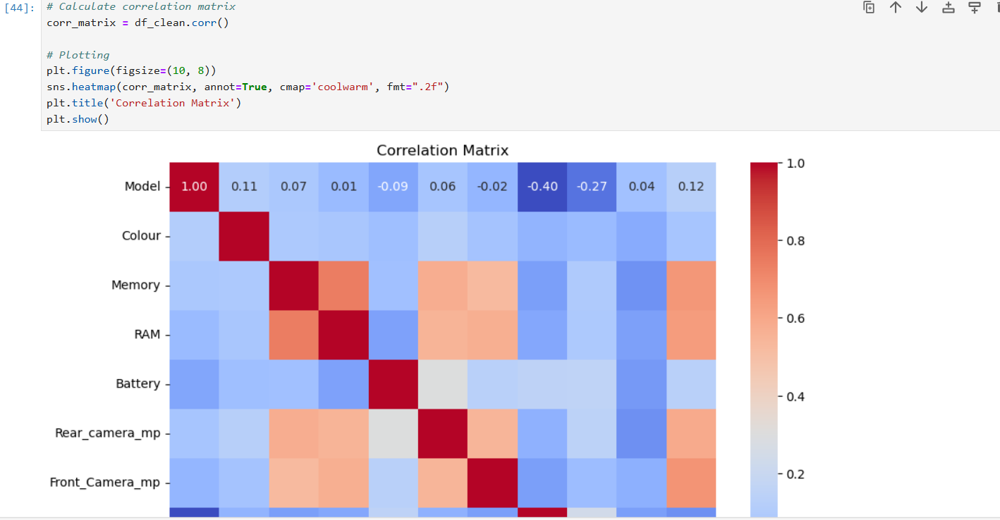

Slide 13
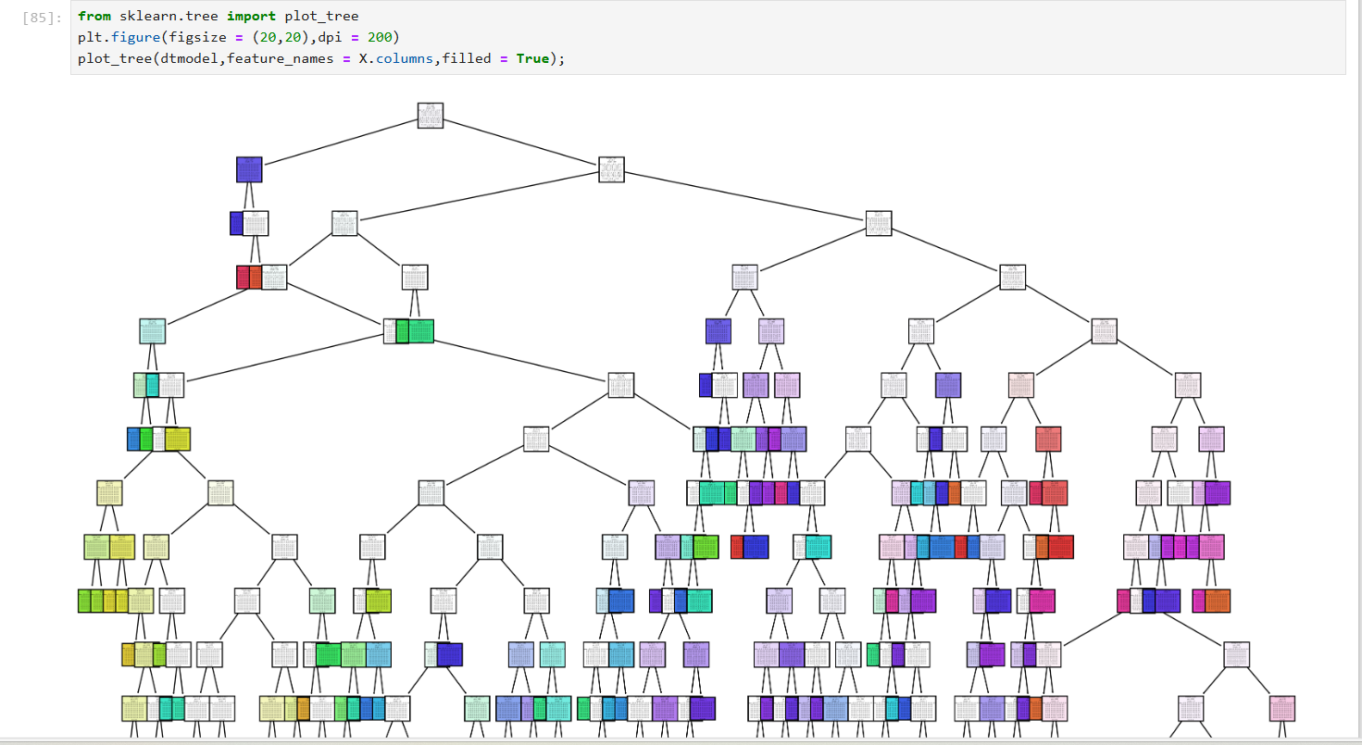

Slide 14
CONCLUSION:-
Linearmodel.score is 0.6280
Price . Mean is 14540.18 after model evaluation.
mean_absolute_error(y_test,y_pred):- 959.78
mean_squared_error(y_test,y_pred) :- 2166955.15
metrics.explained_variance_score(y_test,y_pred): - 0.962

